Slide 1








EV TYPE PREDICTION CHATBOT
PREDICT WHETHER AN ELECTRIC
VEHICLE IS BEV OR PHEV
- SABARETHA JS

Slide 2

Learning Objectives
1.Understand the types of Electric Vehicles (EVs):
• BEV (Battery Electric Vehicle) • PHEV (Plug-in Hybrid Electric Vehicle)
2. Build a machine learning model to classify EV types 3. Use Python libraries: pandas, scikit-learn, and Streamlit 4.Create a user-friendly chatbot interface for EV type prediction 5.Gain experience in deploying ML models as interactive applications
GOAL
Source :
www.freepik.com/

Slide 3

Tools and Technology used
1. Programming Language: Python
• Used for data processing, model training, and building the chatbot
2. Libraries:
• pandas – to handle and process the dataset
• scikit-learn – to create and train the machine learning model (Random Forest)
• streamlit – to build the interactive chatbot interface
3. IDE: VS Code / PyCharm – for writing and managing Python code
4.Platform for Chatbot: Streamlit – provides a simple web interface to interact with the
model
5.Web Browser – to run and test the Streamlit app

Slide 4

Methodology
1. Data Collection:
• Collected dataset of electric vehicles including Make, Model, Model Year, and Base MSRP • Labeled each vehicle as BEV or PHEV
2. Data Preprocessing:
• Handled missing values (if any) • Converted categorical features (Make, Model) into numerical form using One-Hot Encoding
3. Model Training:
• Used Random Forest Classifier from scikit-learn • Split data into training and testing sets (80% train, 20% test) • Trained the model to predict EV type
4. Model Saving:
• Saved the trained model as 'ev_type_model.pkl' for later use in the chatbot
5. Chatbot Development:
• Built an interactive Streamlit app • Users can select Make, Model, enter Year and MSRP

Slide 5

Problem Statement:
1.Electric vehicles (EVs) come in different types: BEV (Battery Electric Vehicle) and
PHEV (Plug-in Hybrid Electric Vehicle)
2. Determining the type of an EV manually can be time-consuming and confusing,
especially with many car models available
3. Users need a quick and accurate way to identify the EV type based on features like
Make, Model, Year, and Base MSRP
4. Goal: Build an interactive chatbot that predicts whether an EV is BEV or PHEV using a
trained machine learning model

Slide 6


Solution:
1.Developed a machine learning model to classify EV type (BEV or PHEV)
2. Used a suitable classifier model in Python foraccuratepredictions 3.Created an interactive Streamlit chatbot:
• User selects Make and Model • Enters Model Year and Base MSRP • Chatbot predicts EV type in real-time
4.Model is pre-trained and saved as 'ev_type_model.pkl' to make predictions instantly 5.Provides a user-friendly interface for easy access and decision-making

Slide 7
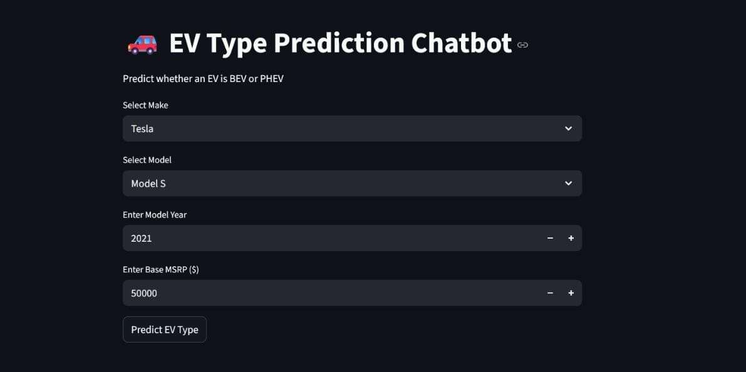
Screenshot of Output:

Slide 8

Conclusion:
1.Successfully built a machine learning model to predict EV type (BEV or PHEV)
2. Developed an interactive Streamlit chatbot for easy and real-time predictions
3. Users can quickly identify EV type by entering Make, Model, Year, and Base MSRP
4. Project demonstrates integration of Python, ML, and web-based user interface
5. Makes EV type identification simple, accurate, and user-friendly

Slide 9
THANK YOU!!!

